Slide 1
Application of the NPMRDS for Performance Management
AASHTO Webinar #2
Rich Margiotta
September 16, 2015

Slide 2
Topics to be Covered
Prepping for NPMRDS analysis
Accessing and downloading the data
Reviewing the data
Integration with other data sources (“conflation”)
Data reduction
Performance measure development
Uses in performance management

Slide 3
Prepping for NPMRDS Analysis

Slide 4
What Resources Are Needed (1 of 2)
A server is not necessary to analyze one state’s data
  Powerful desktop is adequate and a large capacity external HD is strongly recommended
  Files are large: many records but only a few data elements per record
    Florida 2014: 293 million records
    Nevada 2014: 44 million records
Statistical packages are great tools for manipulation
  SAS, R, Tableau are examples
  Visualization tools can make presentations more effective (e.g., Tableau)
  Many folks write their own Python code to do the manipulation
  Excel, Access not powerful enough

Slide 5
What Resources Are Needed (2 of 2)
Specialized data products are also available to aid analysis and visualization
  RITIS, iPeMS, analytic packages from travel time vendors are examples (there may be more)
GIS needed for file conflation and for display of results (if desired)

Slide 6
Accessing and Downloading the NPMRDS

Slide 7
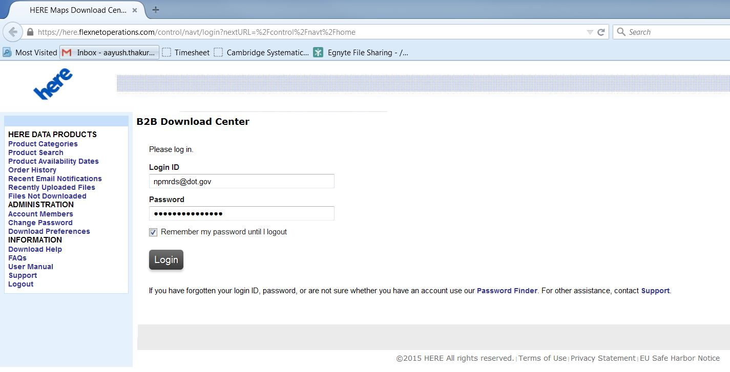
Download Center – Login Page

Slide 8
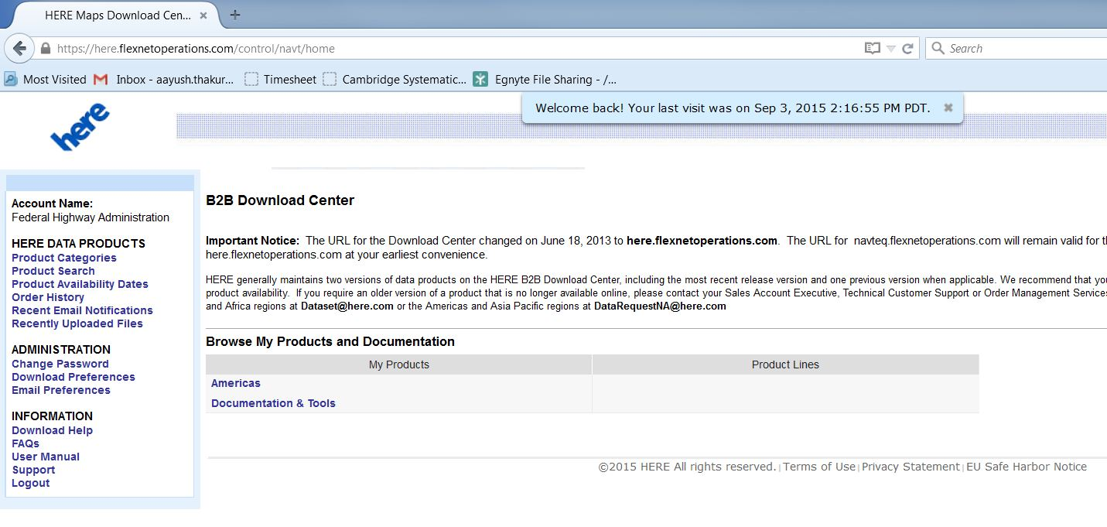
Home Page

Slide 9
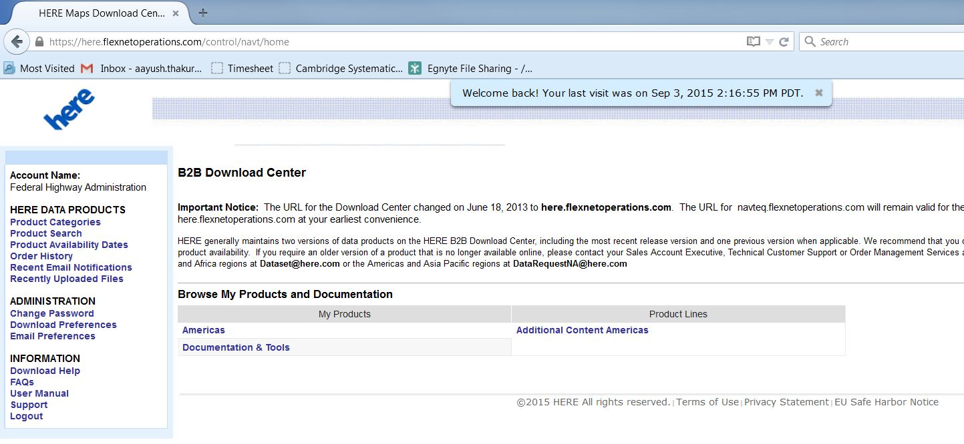
Click on Americas

Slide 10
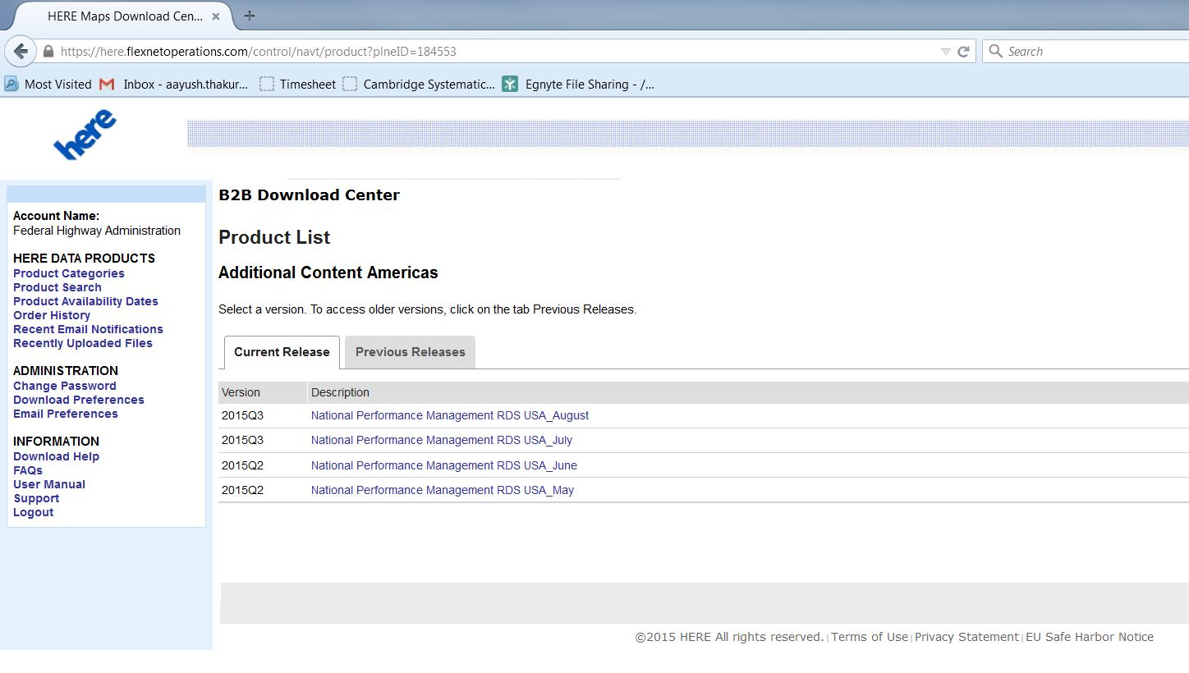
Select the Months For Which You Need Data

Slide 11
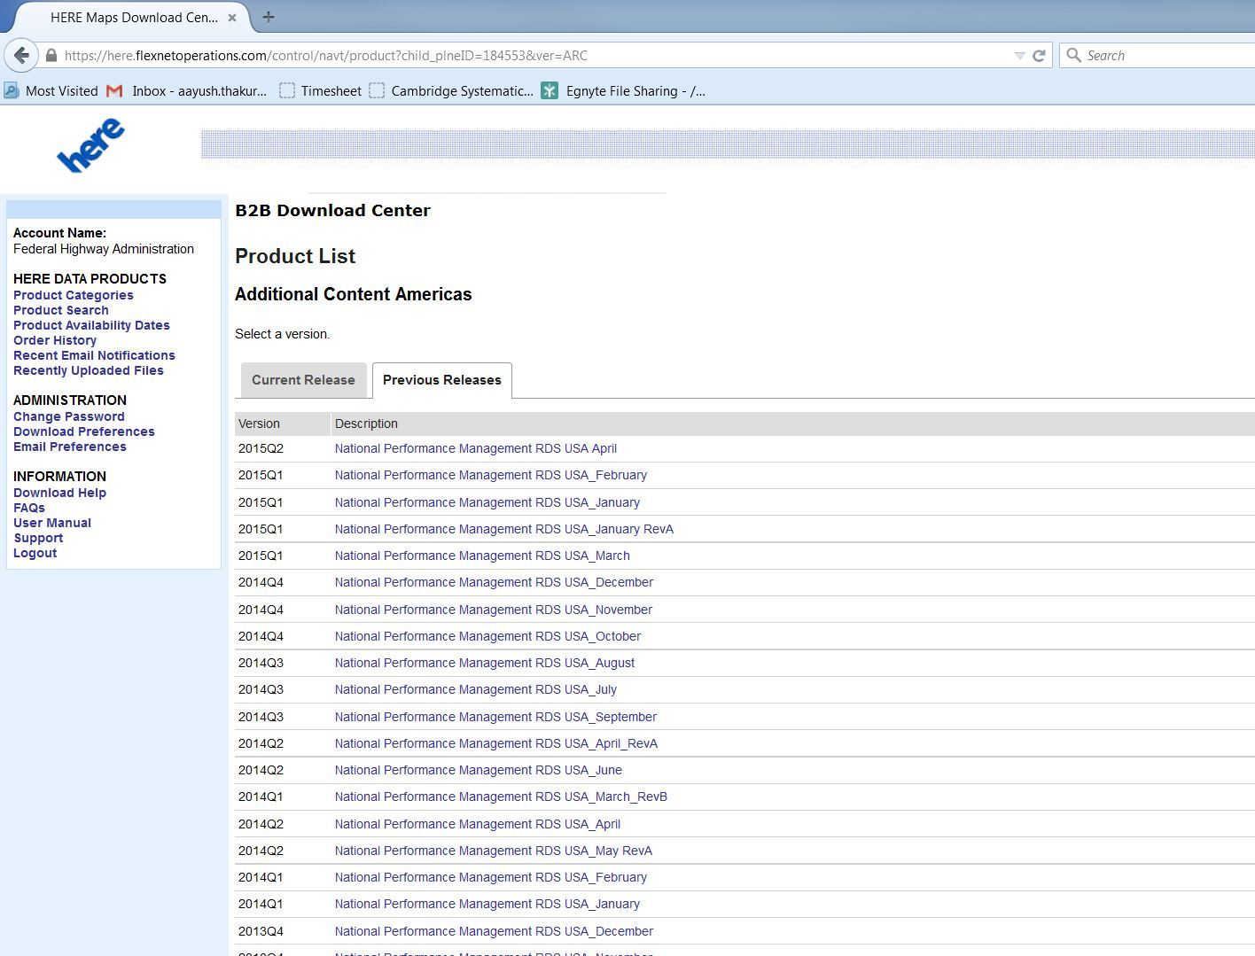
Select the Months For Which You Need Data (cont.)

Slide 12
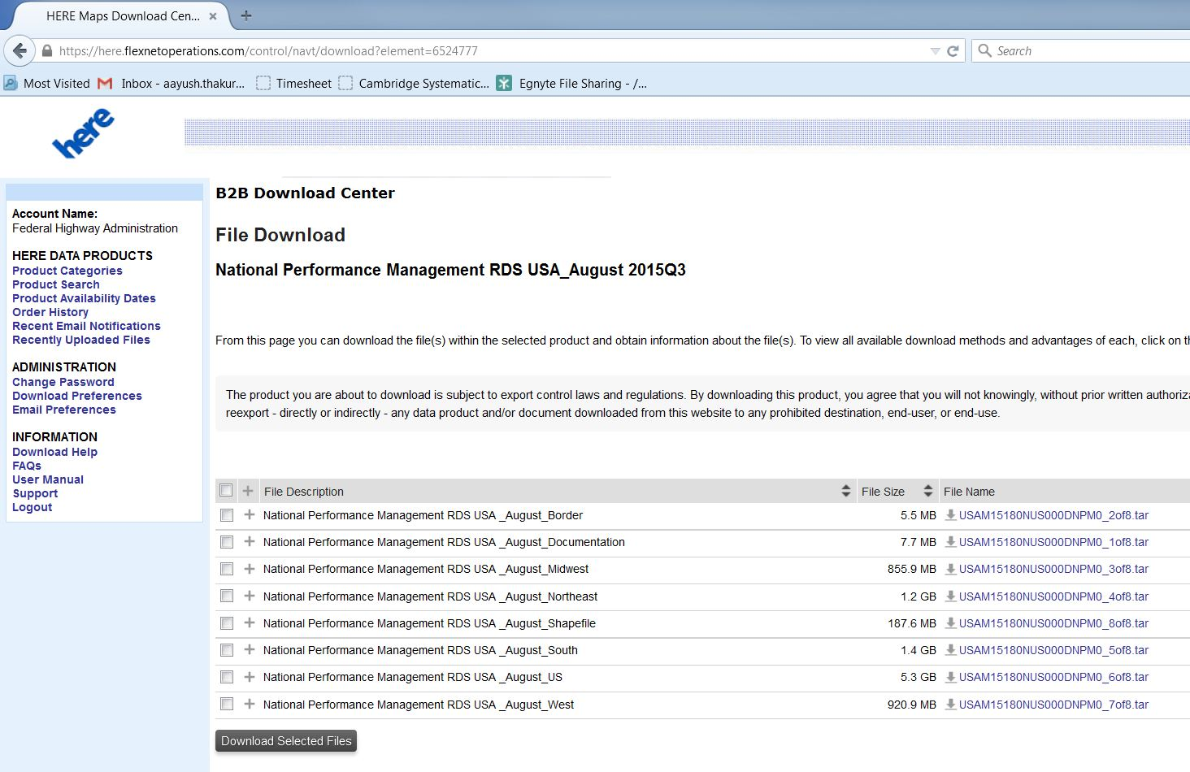
Select the Files You Wish to Download

Slide 13
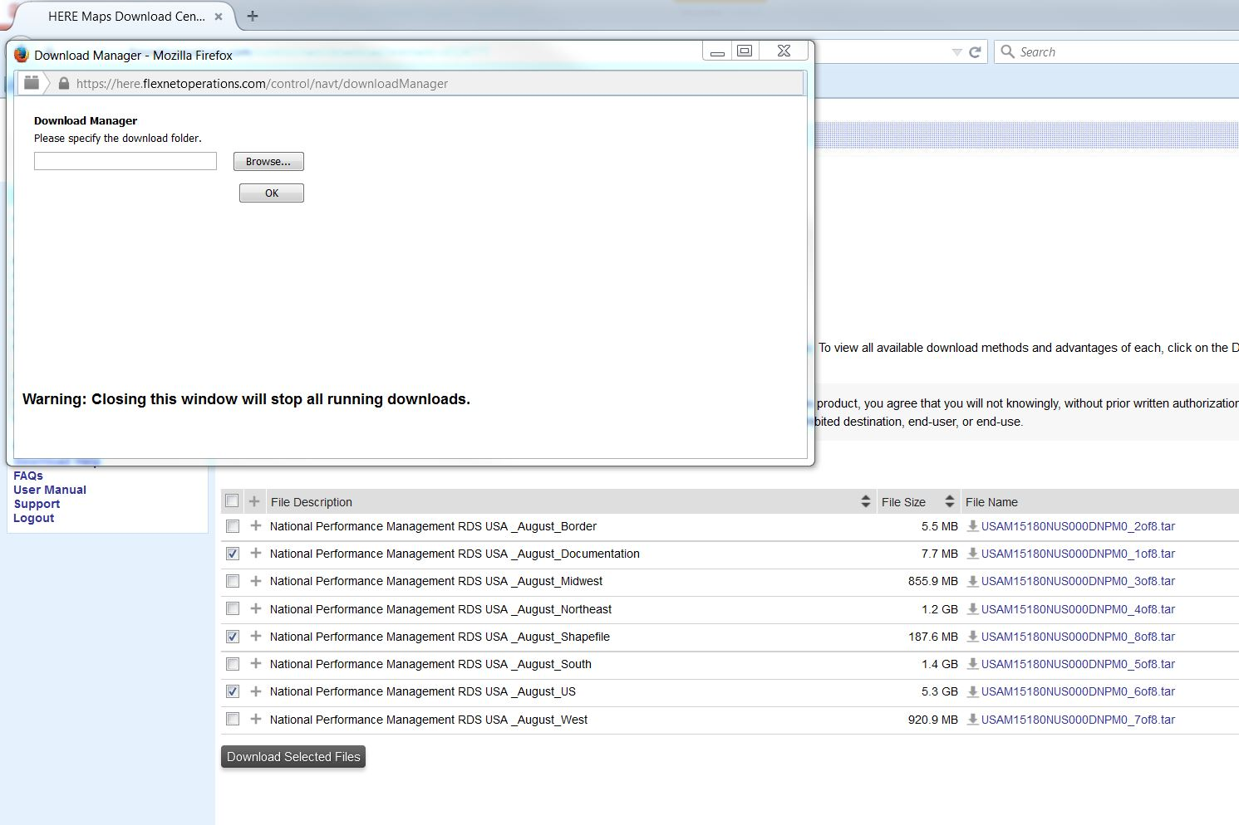
Browse to the Download Folder

Slide 14
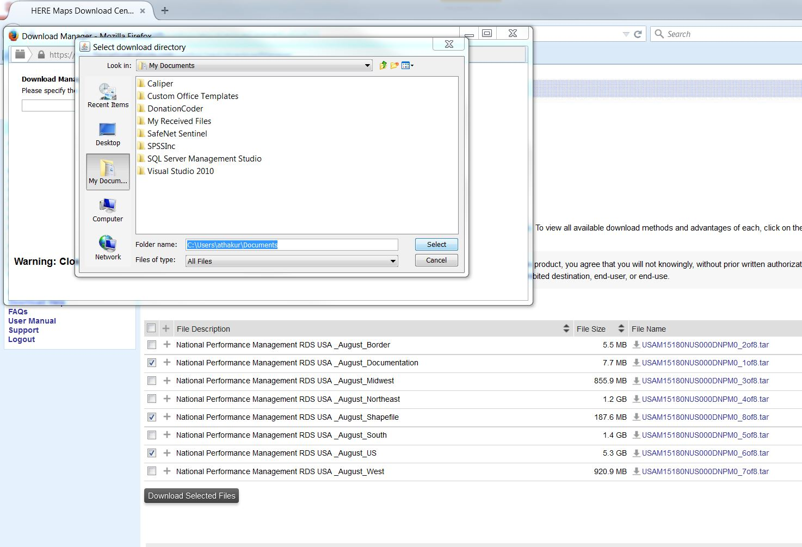
Select the Download Folder

Slide 15
Three NPMRDS Files
Monthly Travel Time Data File
  Contains the travel time data for each day for a 1 month timeframe
  If no travel time measurement exist, there is a missing record
TMC Static File
  Contains descriptive information about the road segment
  Updated ~quarterly
Shape File
  Contains precise road geometry of the NHS and attributes about the road segment
  Updated ~quarterly
Configuration management is extremely important
  Since TMC and Shape Files can change, important to link to Travel Time File by date range

Slide 16
Travel Time Data in the NPMRDS
TMC | Date | Epoch | Travel Time All Vehicles | Travel Time Passenger Vehicles | Travel Time Freight Trucks
115N04294 | 1272014 | 122 | 27 |  | 27
115N04294 | 1262014 | 213 | 24 | 24
115N04294 | 1252014 | 94 | 28 | 28
115N04294 | 1242014 | 185 | 23 | 23
115N04294 | 1242014 | 125 | 22 | 22
115N04294 | 1232014 | 186 | 24 | 24
115N04294 | 1232014 | 156 | 28 | 28
115N04294 | 1232014 | 126 | 23 | 23
115N04294 | 1222014 | 187 | 27 | 27
115N04294 | 1222014 | 97 | 26 | 26
115N04294 | 1212014 | 218 | 32 | 32
115N04294 | 1212014 | 128 | 26 | 26
115N04294 | 1212014 | 98 | 27 |  | 27
115N04294 | 1202014 | 219 | 26 | 26
115N04294 | 1202014 | 189 | 24 | 24
115N04294 | 1202014 | 159 | 21 | 21
115N04294 | 1202014 | 129 | 24 | 24
115N04294 | 1192014 | 211 | 27 |  | 27
115N04294 | 1192014 | 151 | 88 | 88
115N04294 | 1192014 | 121 | 24 | 24
115N04294 | 1192014 | 61 | 30 |  | 30

Slide 17
Quarterly Static File
TMC | ADMIN Level | State | County | TMC Length | Road Number | Road Name | Latitude | Longitude | Road Direction
101N12243 | USA | Alabama | Autauga | 3.0708 | AL-14 | Fairview Ave | 32.46574 | -86.45075 | Westbound
101P12243 | USA | Alabama | Autauga | 0.4051 | AL-14 | Fairview Ave | 32.46574 | -86.45075 | Eastbound
101N12240 | USA | Alabama | Autauga | 1.7211 | AL-14 | Selma Hwy | 32.43816 | -86.47395 | Westbound
101N12241 | USA | Alabama | Autauga | 1.0802 | AL-14 | Selma Hwy | 32.45949 | -86.46992 | Westbound
101P12240 | USA | Alabama | Autauga | 1.9155 | AL-14 | Selma Hwy | 32.43816 | -86.47395 | Eastbound
101N12238 | USA | Alabama | Autauga | 8.5621 | AL-14 |  | 32.43577 | -86.64807 | Westbound
101N12239 | USA | Alabama | Autauga | 1.8429 | AL-14 |  | 32.43083 | -86.50345 | Westbound
101N12242 | USA | Alabama | Autauga | 0.4255 | AL-14 |  | 32.46023 | -86.45149 | Westbound
101P12239 | USA | Alabama | Autauga | 8.5621 | AL-14 |  | 32.43083 | -86.50345 | Eastbound
101P12242 | USA | Alabama | Autauga | 1.1638 | AL-14 |  | 32.46023 | -86.45149 | Eastbound
101P12244 | USA | Alabama | Autauga | 3.1625 | AL-14 |  | 32.48769 | -86.40981 | Eastbound
101N05081 | USA | Alabama | Autauga | 5.1410 | I-65 |  | 32.48632 | -86.40686 | Southbound
101N05082 | USA | Alabama | Autauga | 13.8747 | I-65 |  | 32.54749 | -86.45538 | Southbound
101P05082 | USA | Alabama | Autauga | 5.2390 | I-65 |  | 32.54749 | -86.45538 | Northbound
101P05083 | USA | Alabama | Autauga | 13.8725 | I-65 |  | 32.7328 | -86.53998 | Northbound
101N11433 | USA | Alabama | Autauga | 1.2386 | US-31 |  | 32.42504 | -86.41156 | Southbound
101N11434 | USA | Alabama | Autauga | 2.0926 | US-31 |  | 32.43805 | -86.4253 | Southbound
101N11435 | USA | Alabama | Autauga | 3.5978 | US-31 |  | 32.46006 | -86.45065 | Southbound

Slide 18
Reviewing the Data

Slide 19
Data Quality Control (QC)
The first step in any data analysis is to become familiar with the data
  Is it reasonable? Does it fall into the expected range or are there outliers?
  Where are the holes (missing data)?
No formal rules for conducting QC have been established, but there are some general guidelines that analysts have used (still evolving)

Slide 20
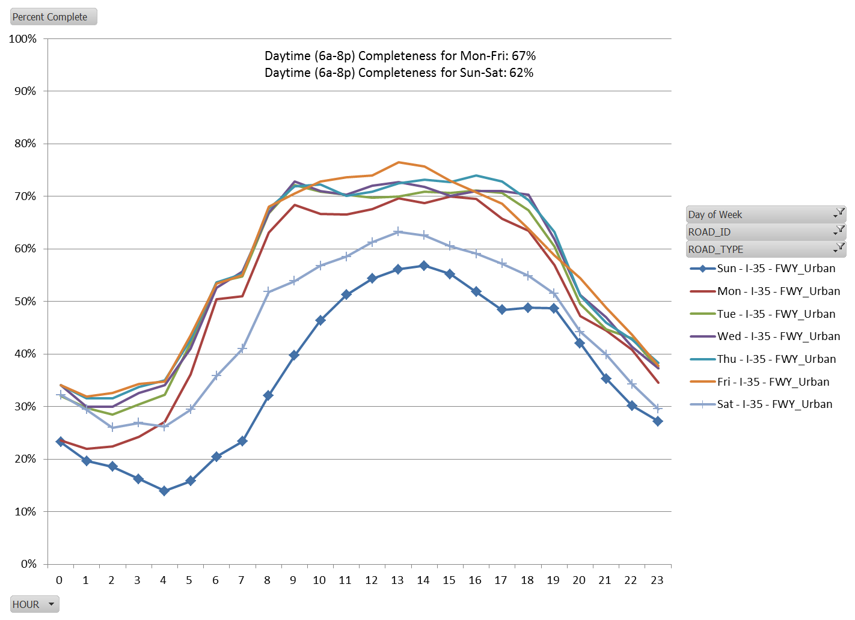
Completeness: Missing Epochs

Slide 21
Outliers: Speed Analysis

Slide 22
Missing Data: What to Do?
Sometimes we need a complete data set to compute measures like delay (which is a sum)
As with QC, no formal rules have been established for imputation, but that hasn’t stopped analysts from undertaking a necessary evil
  Develop factors by detailed cross-classifications with existing data, in a tiered structure
    Average travel time by TMC by DOW by epoch
    Average travel time by TMC by DOW by hour
    Average travel time by roadway by DOW by hour
  Gets less accurate as you move up the chain
  Many other strategies possible

Slide 23
Outliers: What To Do?
Statistical trimming: lop off bottom X% and top Y%
Minimum and maximum speed values
  Best set by highway type
  Deleting high speeds less of a concern than low speeds for performance measures
    Very low speeds are possible with near-full closure and very bad weather
    More sophisticated methods would try to detect these conditions
Typical values (simplistic approach)
  < 2-4 mph
  > {(SpeedLimit or FreeFlow Speed) +10-15 mph}

Slide 24
Integration With Other Data Sources

Slide 25
Conflation Procedures
“Conflation” is the process of matching probe speed data to other roadway data to obtain other data elements for analysis
  Traffic volumes
    Needed to calculate delay
    Proper weighting when aggregating performance measures
    Truck percentages
  Roadway characteristics (e.g., number of lanes, capacity)
  Signalization
The first step in the conflation process is determining which roadway network will serve as the base network for conflation
The process of conflation is facilitated by using geographic information system (GIS) to import and compare the end points of the different networks

Slide 26
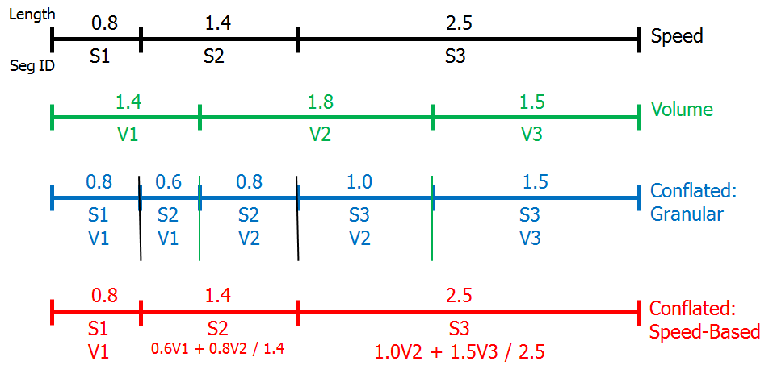
Illustration of the Conflation Process

Slide 27
Development of “Companion” Volumes
We want 5-minute volumes by direction so they can be paired with the NPMRDS travel time measurement, but…
Unless a continuously operating volume detector is present on the conflated network, all we have to work with is AADT
Solution: use default temporal distributions
  State-specific or national defaults
  Really an interim solution because we’re mixing measurements and estimates

Slide 28
Method for Fusing Volume and Travel Time Data
Requires conflation of networks used by each data source
Short-count based AADTs are the vast majority of volume data
  Assign AADT to individual links in travel time network (or vice versa)
  Use default hourly distributions to develop volumes for each time period (epoch) in the travel time data (e.g., divide by 12 to get 5-minute epochs)
  Use default vehicle classification distributions (preferably by hour) to get number of trucks in each epoch
Not ideal but paired volume/travel time measurements rarely exist
  Exception: Freeway ITS detectors

Slide 29
Example Temporal Distribution

Slide 30
Data Reduction

Slide 31
Roadway Segmentation
Basic analysis units for congestion and reliability
“Not too long, not too short, just right”
Short links subject to high variability
Long links mask effect of bottlenecks
Freeways
  3-5 miles in urban areas
  5-10 miles elsewhere
Signalized highways
  Include multiple intersections; length depends on signal density

Slide 32
Developing Travel Times For Corridors or Trips
Simple approach: add up travel times for all TMCs for each epoch
  Reasonable for relatively short distances (< 10 miles) but for longer distances “time/space displacement” becomes an issue
Complex approach: trajectory (virtual probe) method
  Simulate the movement of a vehicle in time and space, capture travel time over corridor
  Closer to true corridor travel time
Missing data can confound both methods
  If imputation has not been done, just expand existing data as a sample

Slide 33
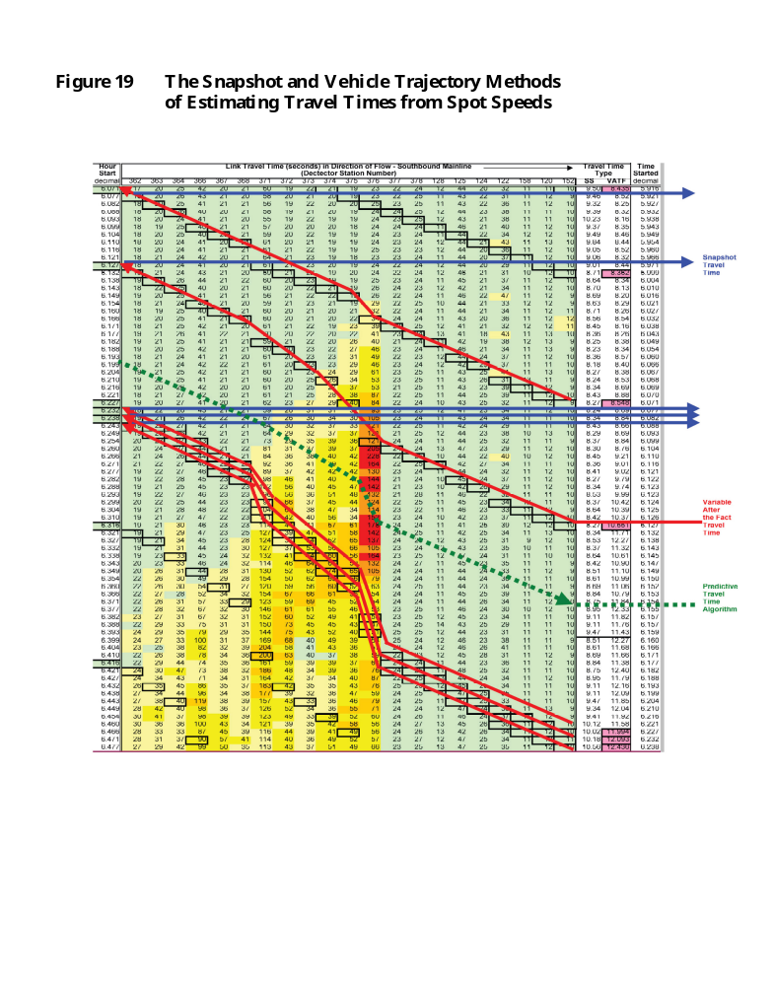
Vehicle Trajectory (Virtual Probe) Method

Slide 34
Calculating the Reference Speed for the Measures
Multiple philosophies, each with pros and cons
  Really just a “sliding scale” for ranking, but does affect the amount of delay used in benefit/cost analysis
Guidance
  Agencies should be free to use their approaches for conducting congestion analyses
    Policy-based vs. data-based
  A standard method provides the ability to compare across areas
    Agencies can still use their own approach for decisions, but also report the measures based on the standard method
  Standard method based on analyzing probe data during weekend early morning hours

Slide 35
Reference Speeds from the NPMRDS
State | Roadway | Average Reference Speed (Computed as Free Flow Speed) (Miles per Hour)
 |  | Passenger Cars | Trucks | Combined
Florida | Interstate | 73.0 | 63.5 | 71.3
 | Remainder NHS | 48.3 | 45.3 | 48.0
Tennessee | Interstate | 70.0 | 62.2 | 66.0
 | Remainder NHS | 49.9 | 46.5 | 49.0

Slide 36
Performance Measure Development

Slide 37
Wide Variety of Performance Measures Possible
Now that we have the building blocks of travel time, distance, reference travel time, and possibly volumes, we can develop a suite of measures
  Total Delay (vehicle-hours)
  Mean Travel-Time Index (MTTI)
  95th percentile Travel-Time Index
  80th Percentile Travel-Time Index (P80TTI)
  Other percentile based indices
  Queue lengths
  % time spent under congested conditions
  % highway miles experiencing congestion
  Etc.

Slide 38
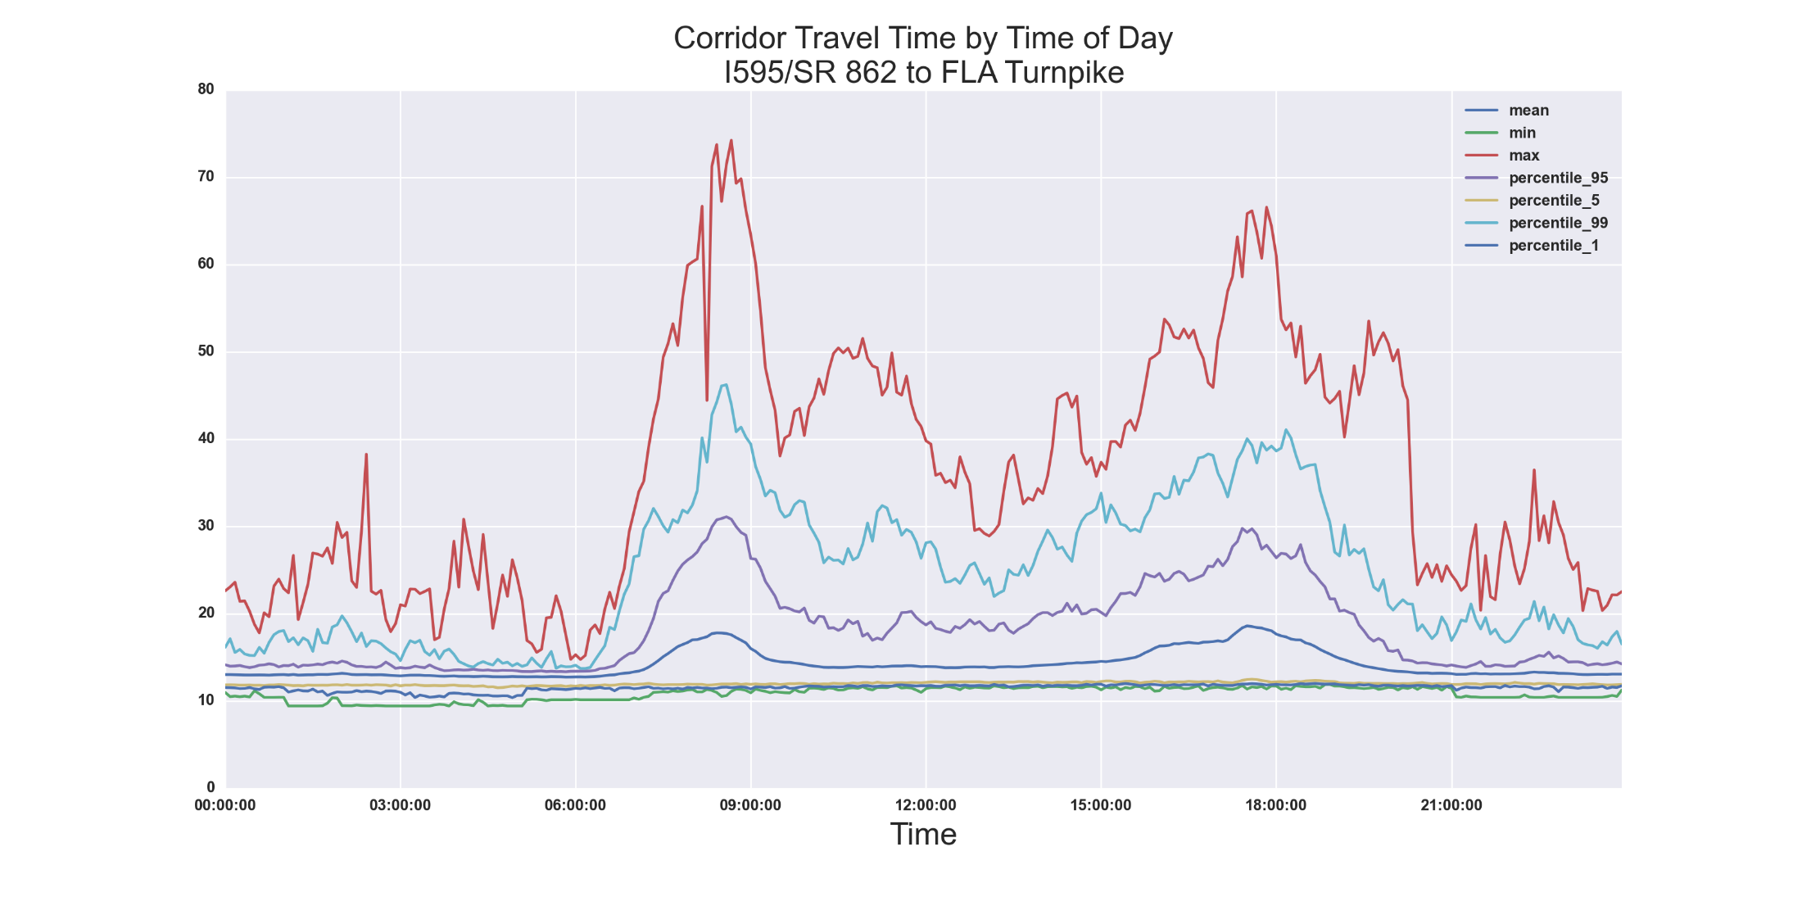
Example of Facility Performance Measures

Slide 39
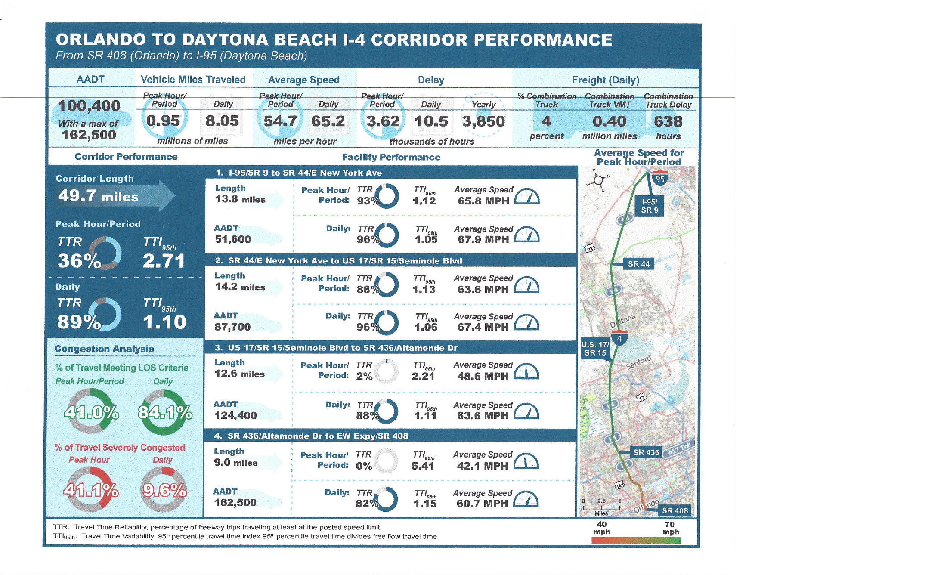
Example Corridor Report

Slide 40
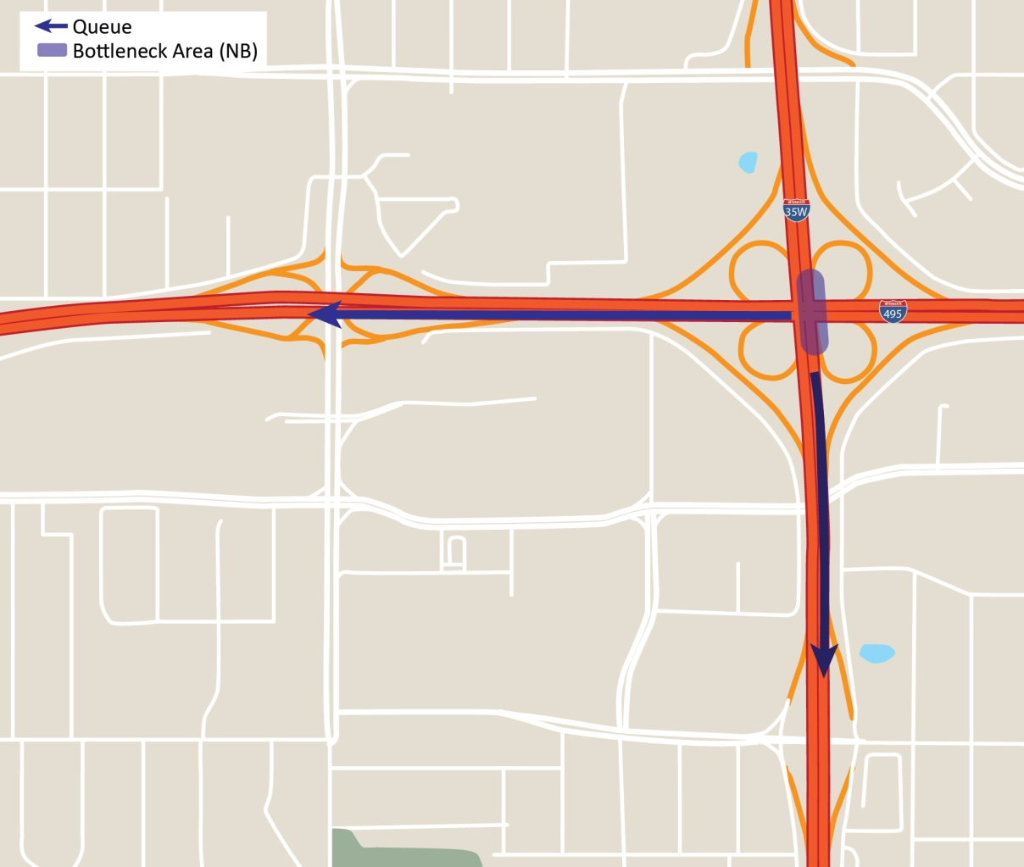
Capturing Queues at a Bottleneck

Slide 41
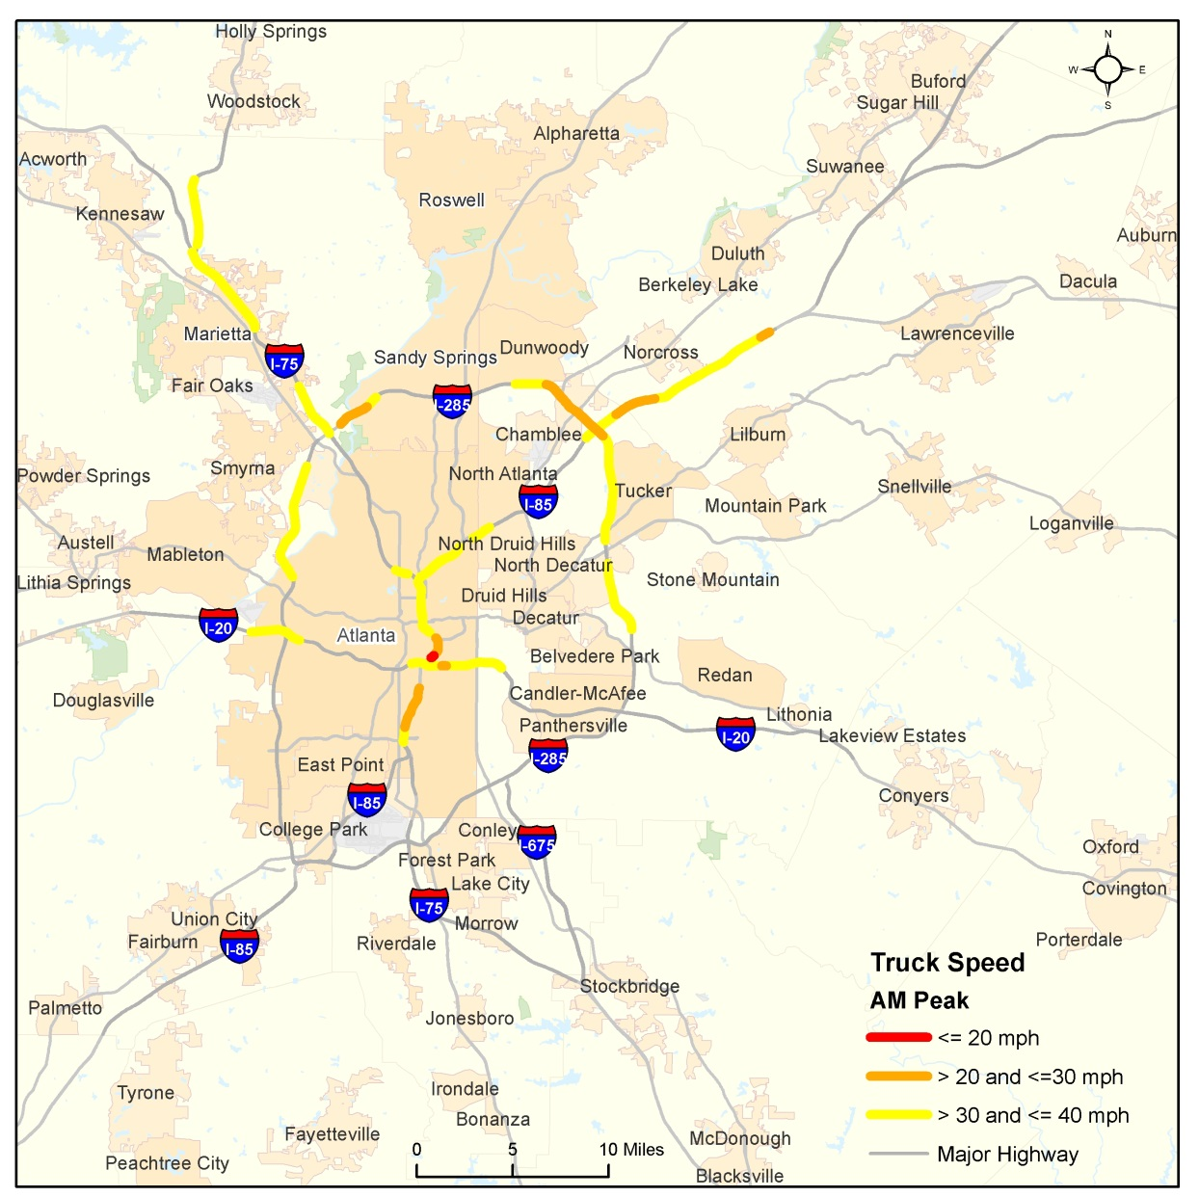
Truck-Specific Congestion Hotspots

Slide 42
Additional Examples of Performance Measures
Many agencies doing interesting things with the NPMRDS
FHWA will be developing a compendium of example applications so that agencies can get an idea of what their peers are doing
FHWA also will develop guidance on MAP-21 performance measures for congestion, reliability and freight performance after Final Rule is published

Slide 43
NPMRDS Uses in Performance Management

Slide 44
Overview
So far, we’ve focused on performance measurement, which is a component of performance management
Performance management is a process of making decisions based on performance measurement and entails several activities

Slide 45
The NPMRDS Supports the Performance Management Process
Goals and Objectives
NPMRDS
Refine Measures
Develop Performance Measures
Adjust Targets
Provide Data
for Forecasting
Establish Targets
Develop Program and Strategy Types
Develop Annual Report, Dashboard, and MAP-21
Continuous Monitoring
Monitor Conditions and Trends Empirically
Bottleneck ID
and Corridor Performance
Identify Problems; Implement Projects and Policies
Library of
Benefits and Costs
Provide Data for Evaluations
Evaluate Actions
Success
?
Y
N
Remediate Original Action
Annual Target
Achievement Report
Assess Progress Toward Targets

Slide 46
Conducting Evaluations
Historically, we have done exhaustive planning and forecasting of what we expect projects to achieve, but infrequently do we investigate what actually happened. Even then, data has been a serious limitation.
NPMRDS (and data like it) is the core of an on-going evaluation system
  Data are already in place – no special collection needed
  Provides data of primary interest: congestion and reliability
  Supporting data needed for explanation and controls
    Demand, incidents, weather, work zones

Slide 47
Thank you!
Richard Margiotta
rmargiotta@camsys.com
Presentation available at:
http://transportationops.org
NPMRDS Help Email:
NPMRDShelp@dot.gov

